Slide 1
New Features in Visual Studio 2017
Raoul Holzer (@RaoulHolzer)
Andreas Willich (@SabotageAndi)

Slide 2
Features
New Installer
Live unit testing
Debugging enhancements
Advanced IntelliSense & Code navigation changes
Extension Roaming Manager
Redgate
Git, Continous Delivery & Docker
Azure Integration

Slide 3
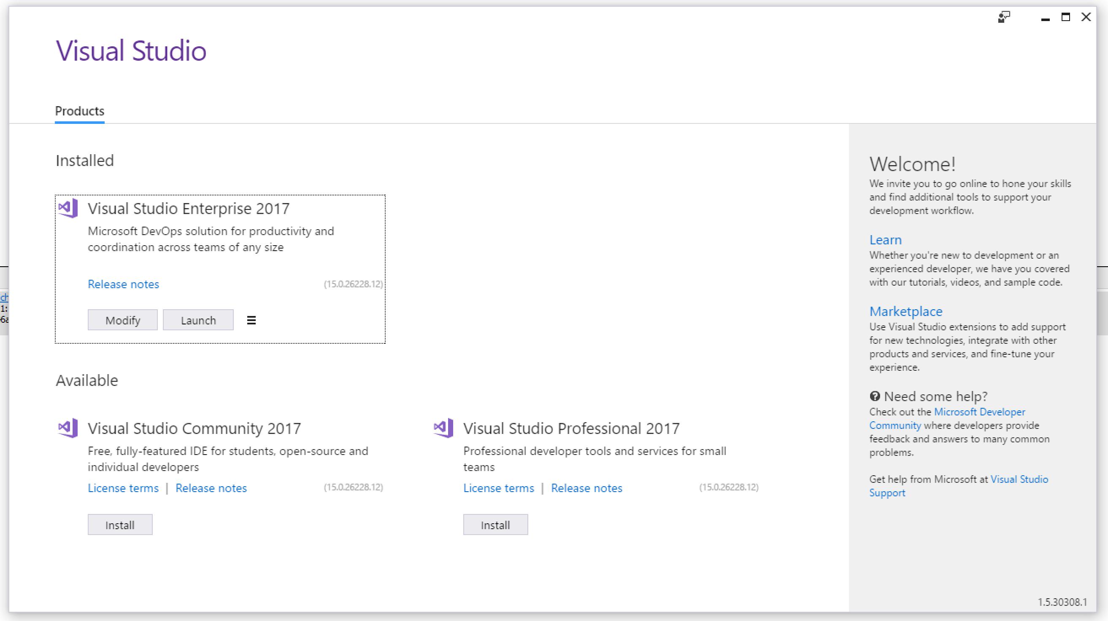
New Installer

Slide 4
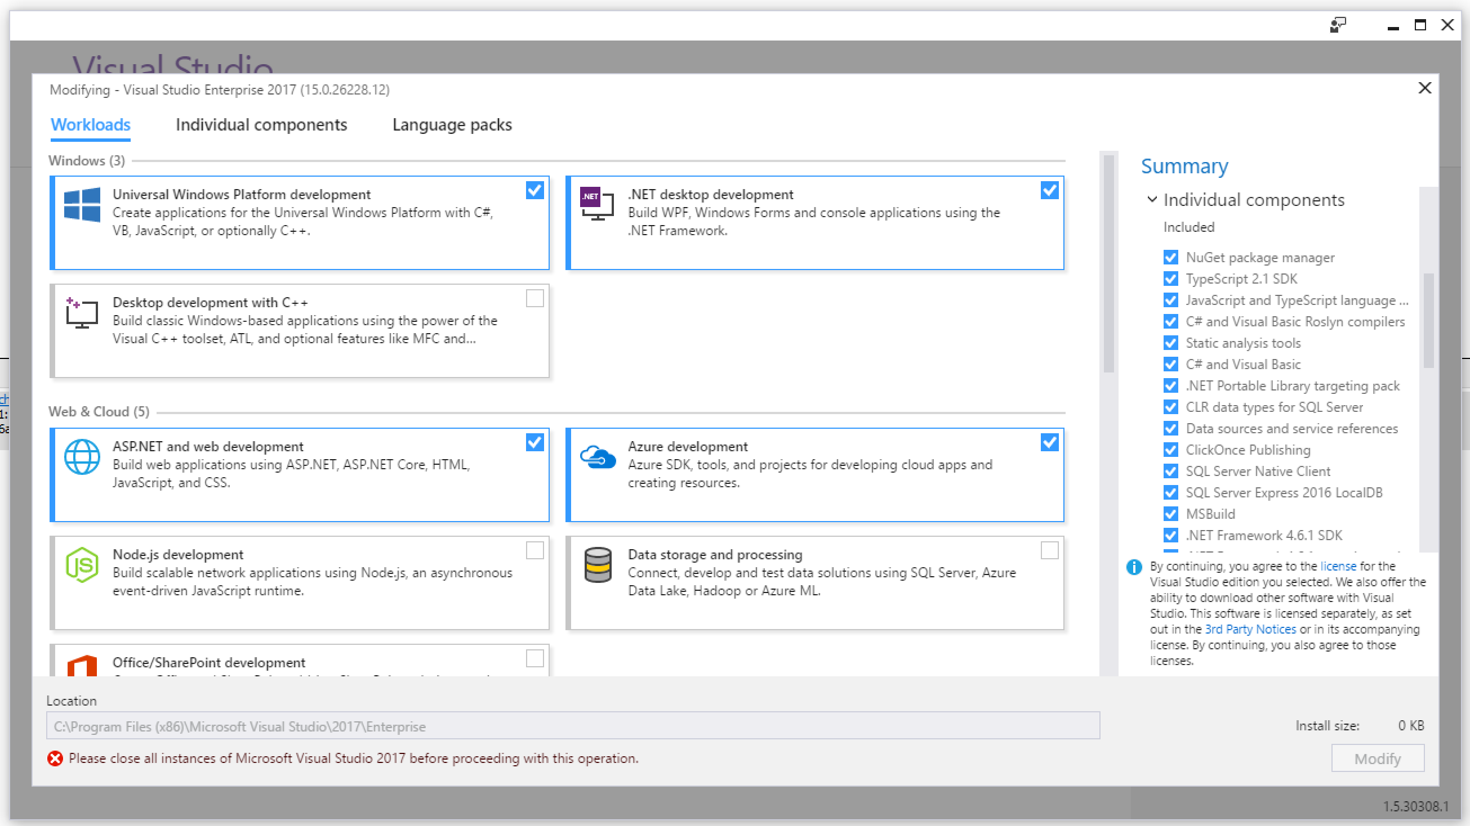
Different Payloads

Slide 5
Good to know
No offline installer available from Microsoft
Because of 3rd party components
You are able to make it on your own
https://docs.microsoft.com/en-us/visualstudio/install/create-an-offline-installation-of-visual-studio
https://www.hanselman.com/blog/HowToMakeAnOfflineInstallerForVS2017.aspx
Multiple Versions parallel installed
Max Framework Dev Tools installed: .NET 4.6.1

Slide 6
Lightweight solution load

Slide 7
Advanced IntelliSense & Code navigation changes

Slide 8
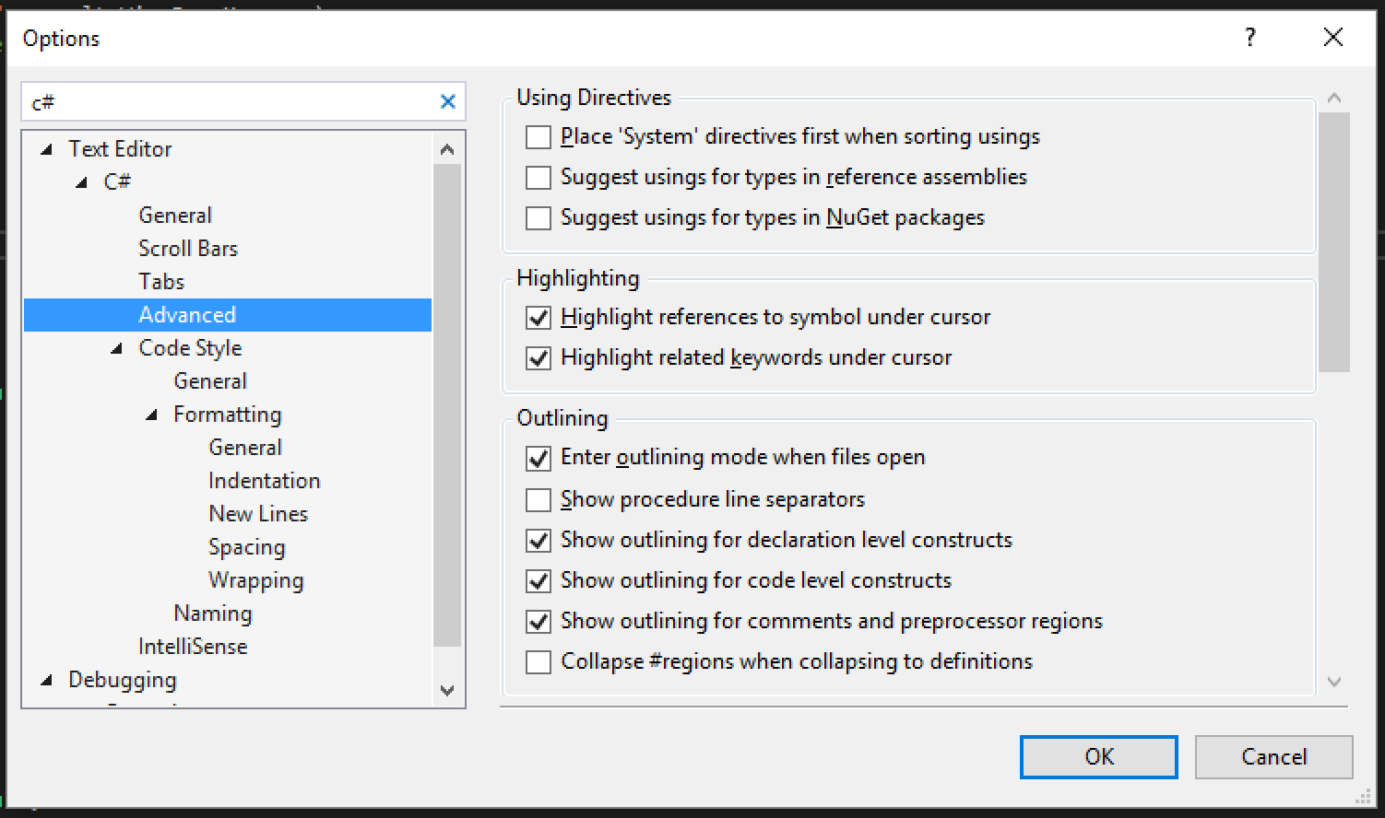
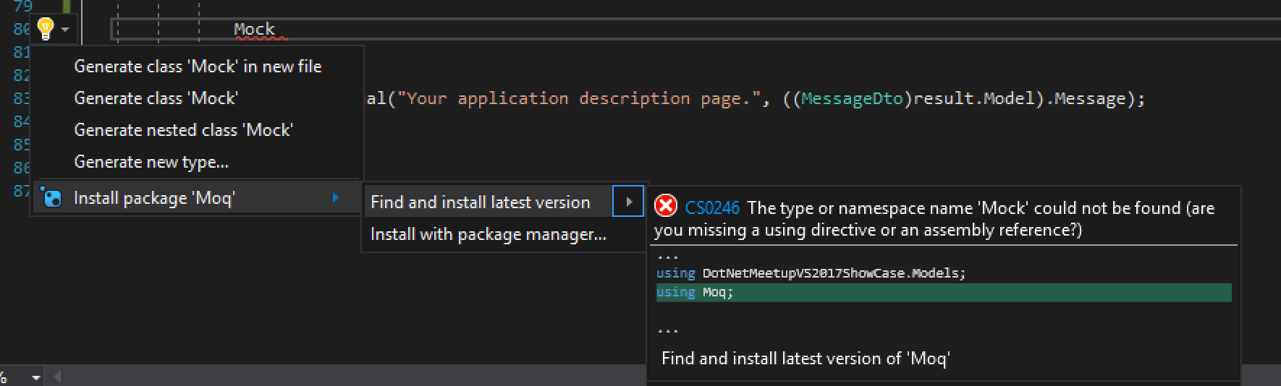
NuGet package suggestion

Slide 9
Important shortcuts
Ctrl+. (Dot) => R# Alt+Enter
Ctrl+, (Comma) => Goto All

Slide 10
.editorconfig

Slide 11
Test Explorer Improvments

Slide 12
Live unit testing

Slide 13
Debugging enhancements

Slide 14
Extension Roaming Manager

Slide 15
C#7 und ASP.Net Core by Christian Nagel
25. April 17:30
https://www.meetup.com/NET-User-Group-Austria-Meetup/events/238222081/

Slide 16
Thank you!
Questions?

